Slide 1
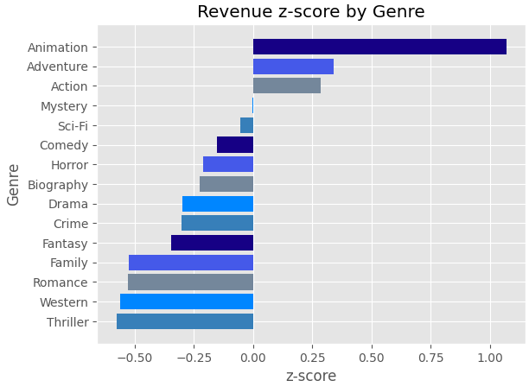
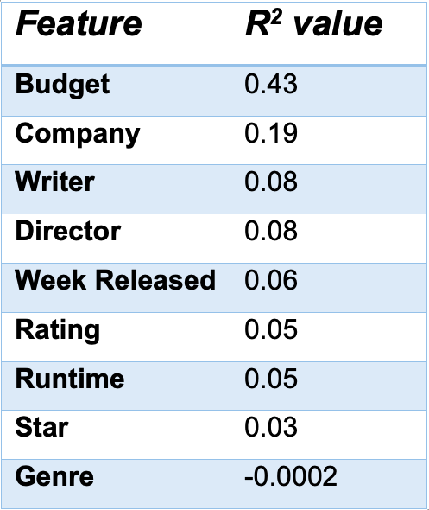
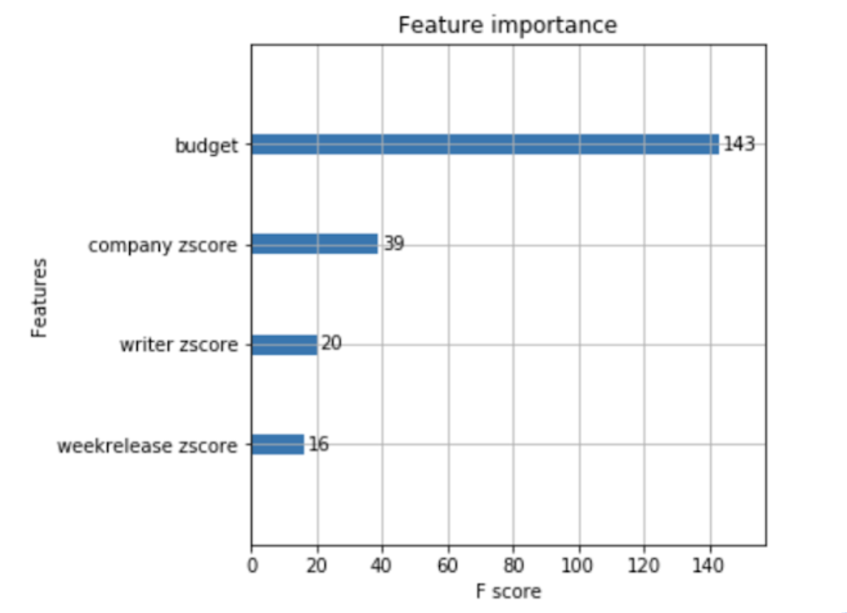
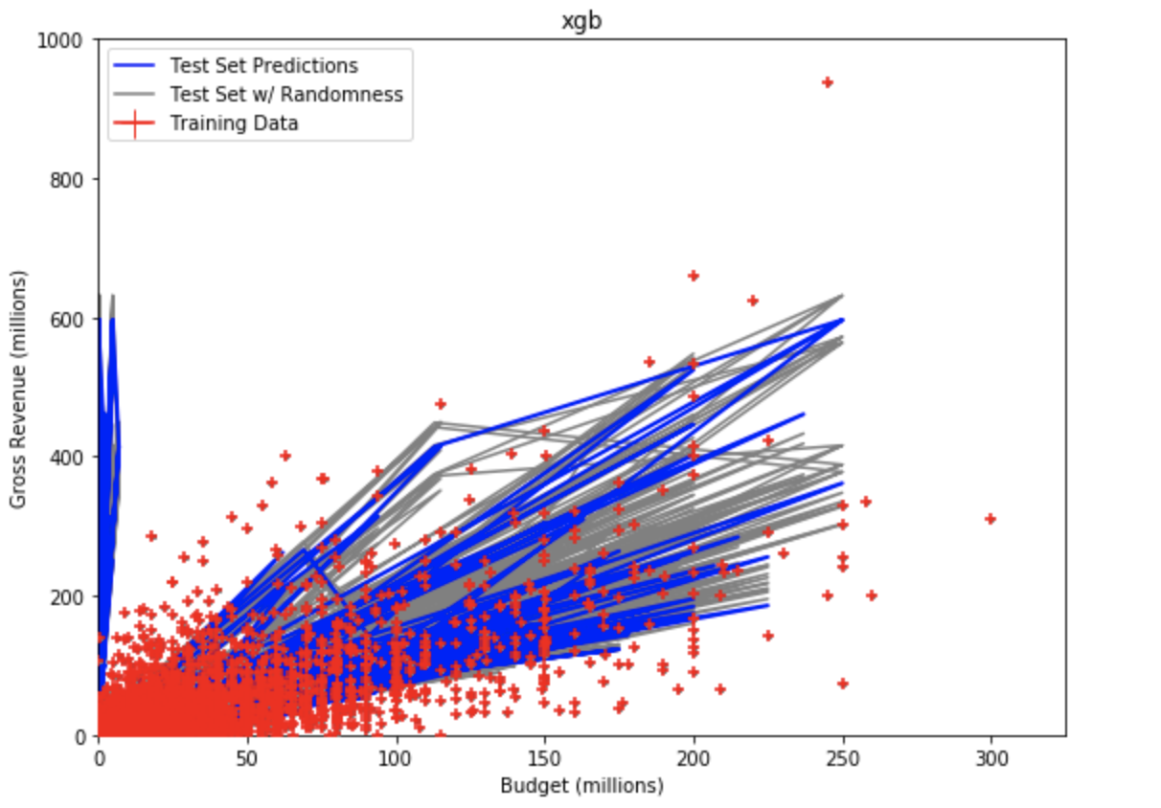
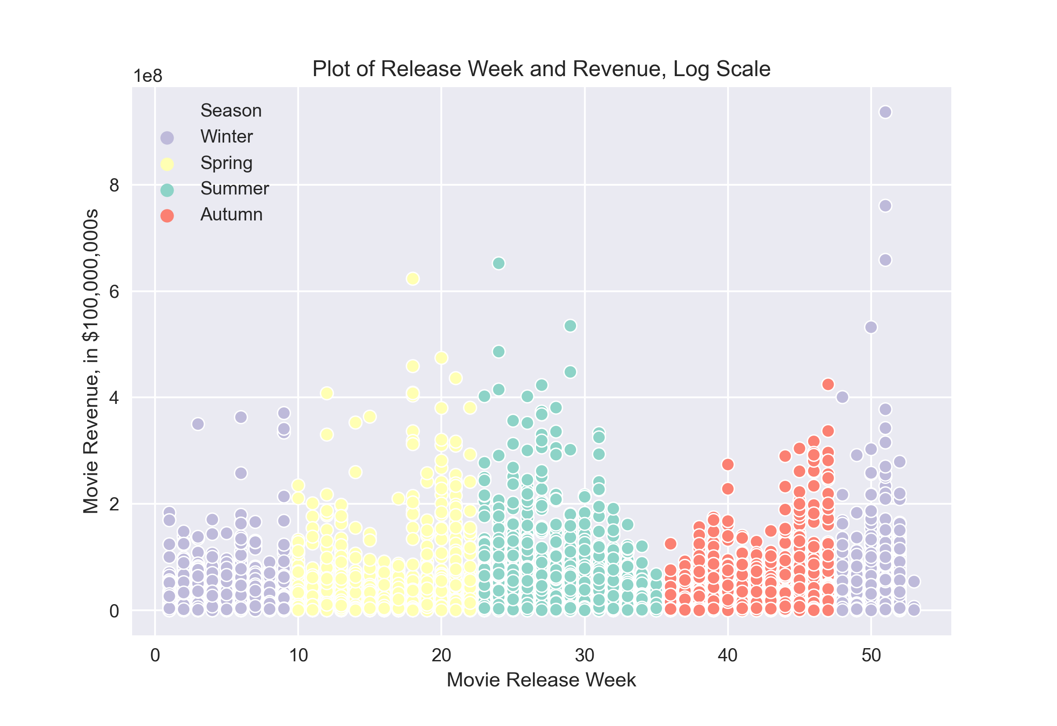
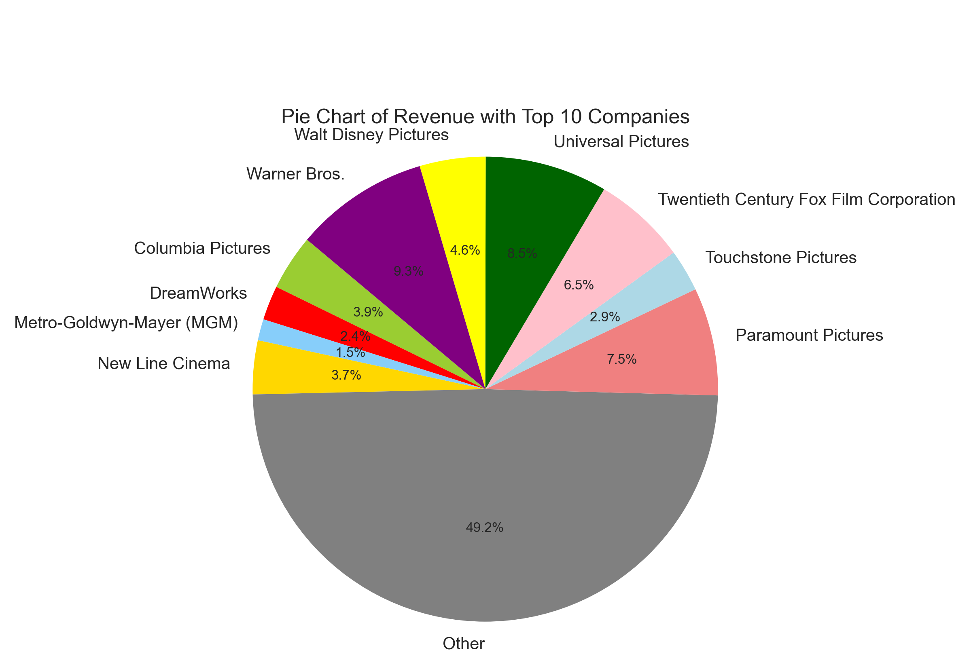
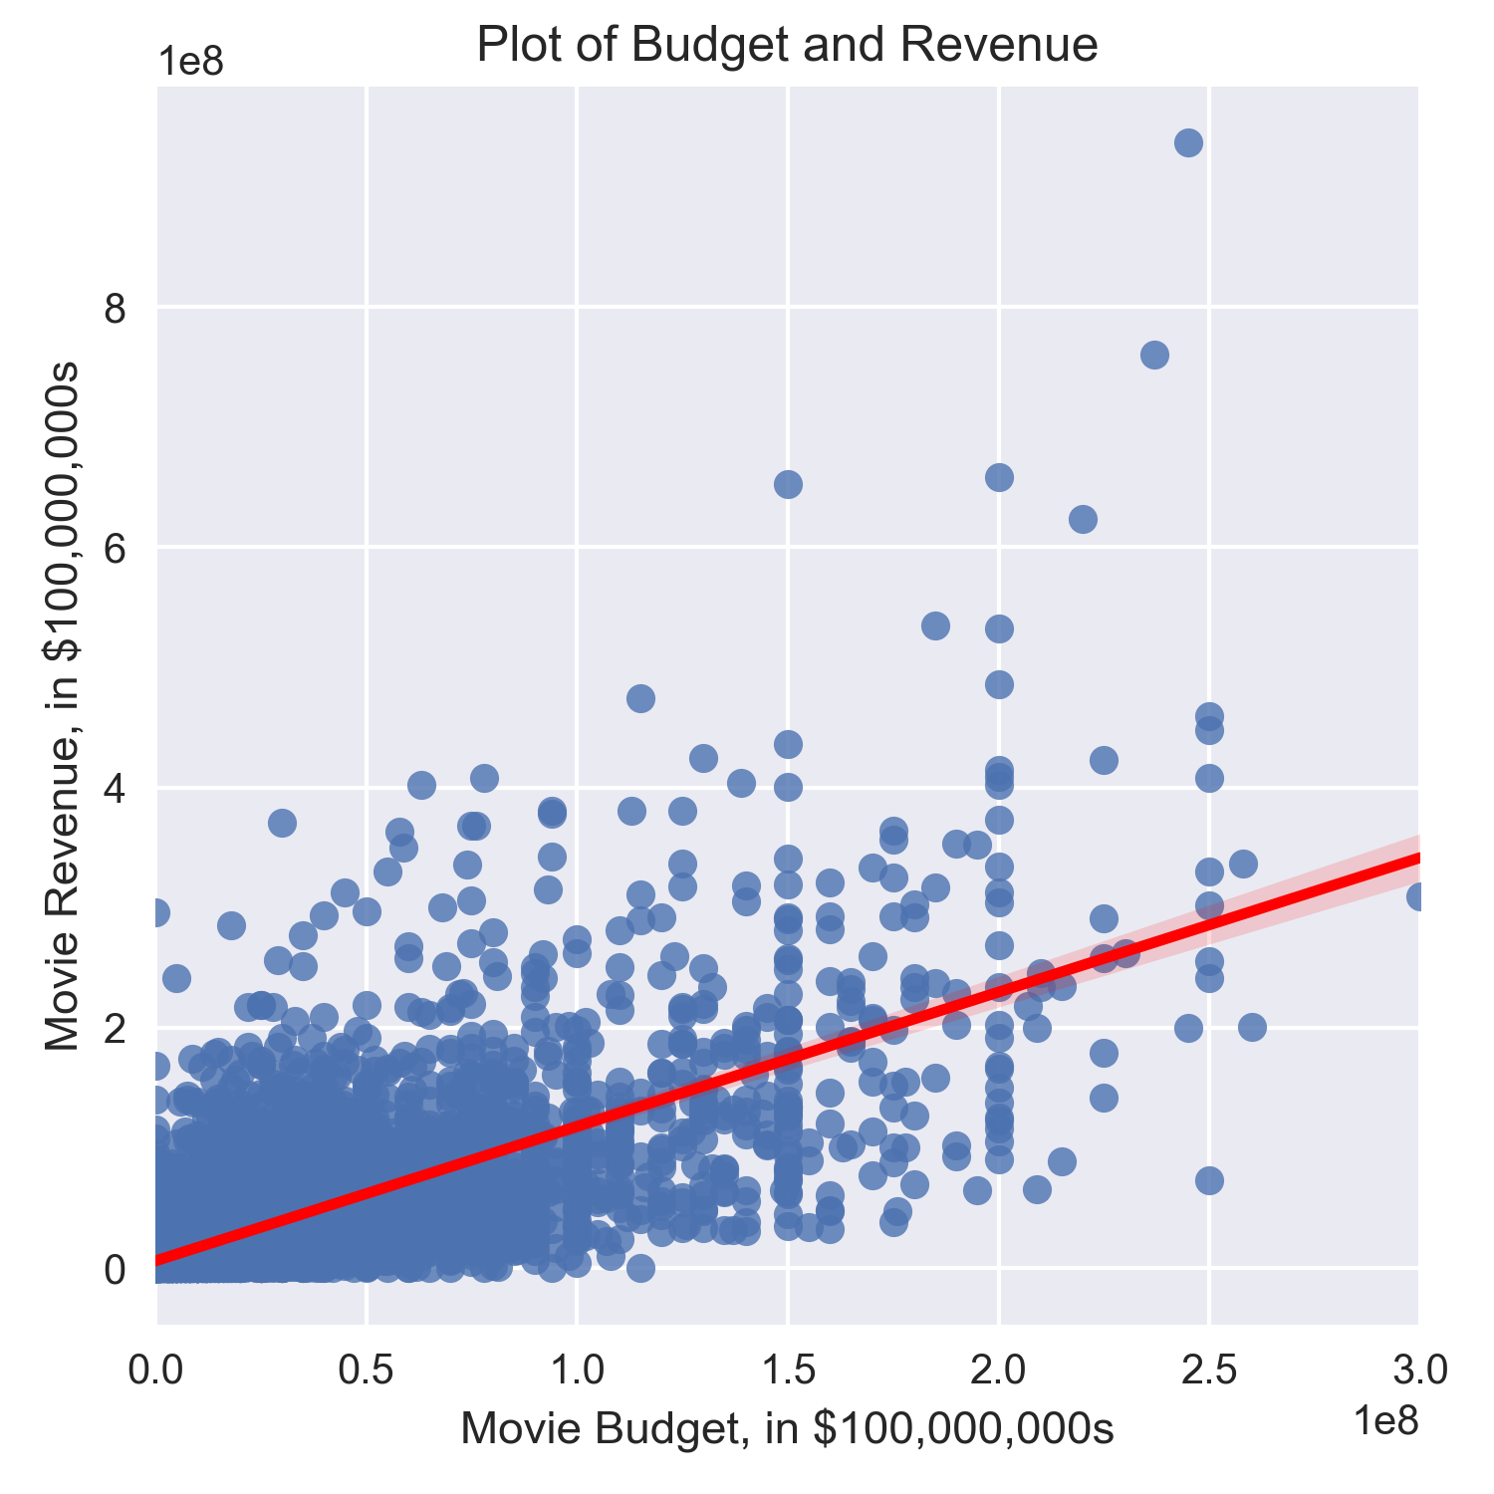
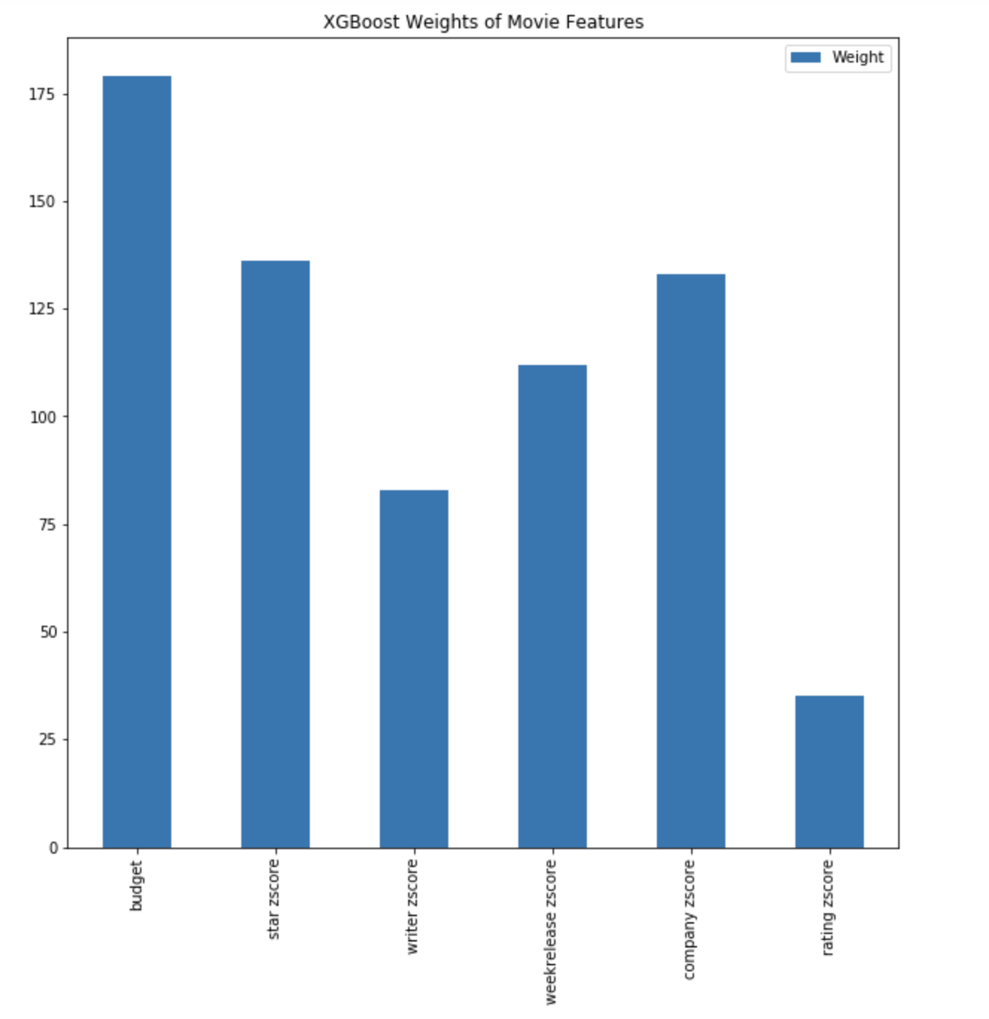
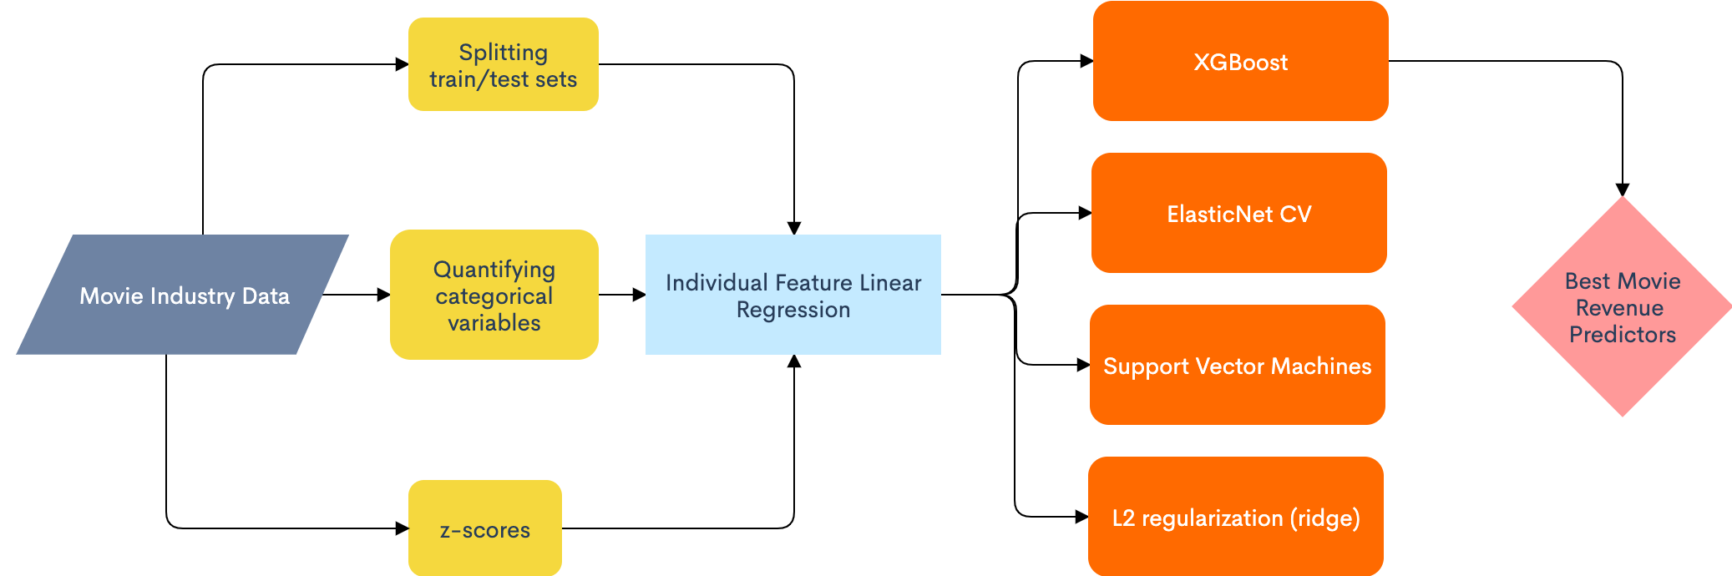
Identifying Best Predictors for Movie Revenue through Supervised Learning Models
Highlights
Budget is the most important factor in determining a movie’s revenue.
The combination of budget, company, writer, star, week of release, and rating makes for the best revenue-predicting model.
We can explain much of the variance in movie revenues with these factors.
Konstantin Larin, Willie Turchetta, Connie Xu, Brandon Zhu
Model
We tested a variety of supervised learning models, a combination of regressions, decision tree, and vector models. We found that a XGBoost decision tree regression yielded the best error and precision.
Initial exploration gives R² value and regression graphs - preliminary information from which we built our models.
Our XGBoost algorithm lists the relative feature importance, and assigns budget the highest weighting to predict revenue.
Background
The global movie industry is worth over $130 billion dollars. However, a large number of films lose money, so it is vitally important for movie producers to be able to estimate the revenue the movie will bring before that movie gets released.
Data
We used movie_industry.csv, which provided us with the most number of features which we could use as input features for our model. We split the data into a training and test set. Then, to normalize the data, we calculated the z-score of each input feature based on its revenue.
Budget, followed by company, writer, and week release are the best predictors for movie revenue.
Nuance
The input features we analyzed were limited to the information that was provided on the data set, so there could be other important features which we did not cover which could better our model results even more.
Notes:
Notes:
In Powerpoint, click View > Guides
Keep text within gutter guides.
Author list: Don’t split names onto two lines (e.g., “Jimmy [break] Smith”). If that happens, use a new line, unless you need the space. Bold the first names of anybody who’s presenting in person.
Intro/methods/result: Do not drop below font size 28, but if you have extra space, jack up the font size until the space is full.
Do not use color in the sidebars except in graphs/figures. It’ll pull attention from the center and slow interpretation for passersby.
Our model yielded the best root-mean-squared error and lowest variation (R2 coefficient), which clearly beat XGBoost and Support Vector Machine Regression.

